Slide 1
Pentecost presentation!
Today we are showing you about what we have done in RE

Slide 2
The power of wind
Today we talked about wind and what it can do then we got in partners and let go balloons one fast and the other slowly.

Slide 3
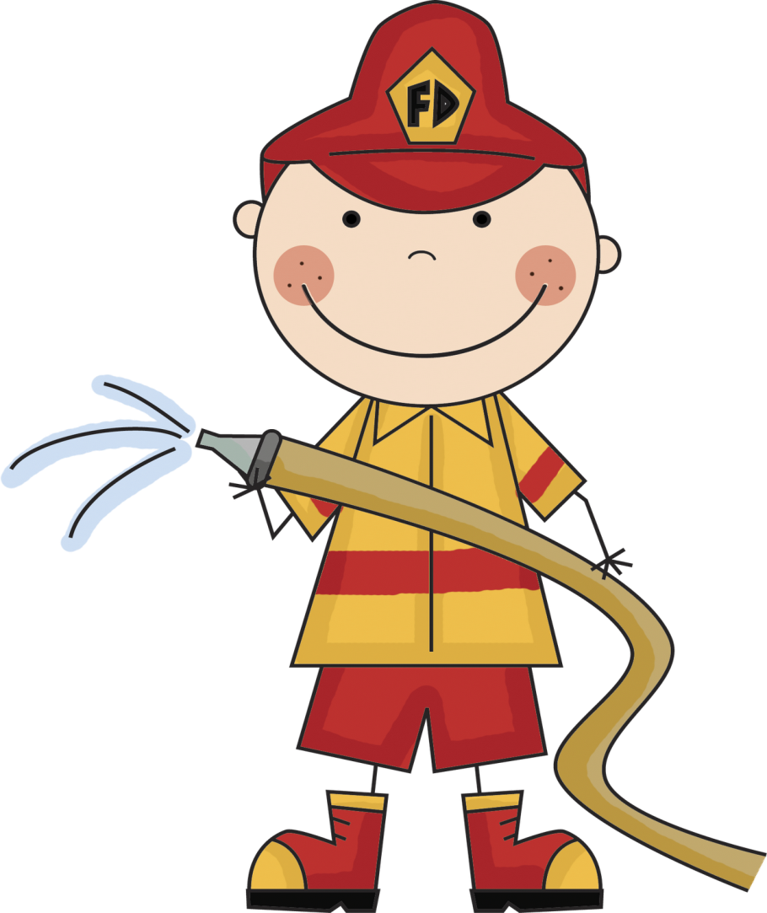
The power of fire
Today we got in groups and talked to each other, we wrote down what fire can do and how it could affect other things around us.

Slide 4
Windmills
Today we all made fabulous windmills with information inside it, we still need to let the wind blow them round.

Slide 5
Music
Today we got in groups and made some music about Pentecost, we used instruments to make the beautiful music.

Slide 6
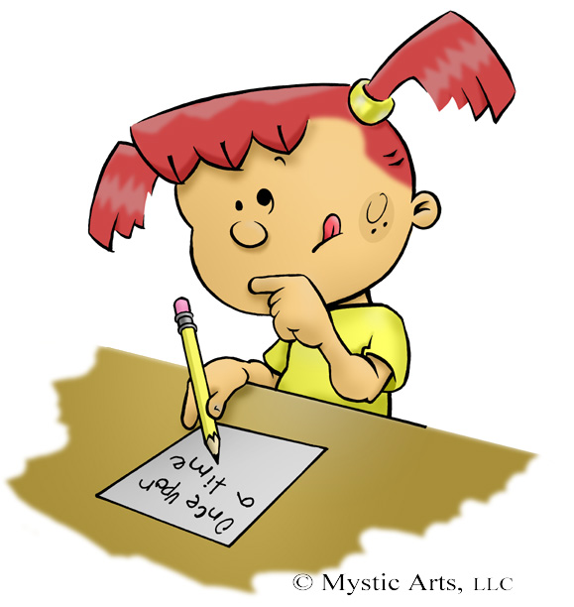
Powerful poets and feelings
Today we all learned about Pentecost, after that some of us made poets on our word webs and others wrote about feelings at the time and put it on our word webs.

Slide 7
Speech
Today we wrote a speech for Peter about when the holy spirit came.

Slide 8
Word art
Today we made a picture of the word peace in different ways.

Slide 9
The gifts of the Holy spirit
Today we looked at all the gifts of the Holy Spirit and then we wrote about them and what we would use them for.
These are the gifts:
Reverence
Courage
Knowledge
Wisdom
Awe and Wonder in God’s Presence
Understanding
Right judgement

